Slide 1

Image Captioning
CSE 499A Project
Group Members
Shahil Azmayish
1721552042
Zahidul Islam
1721957642

Slide 2
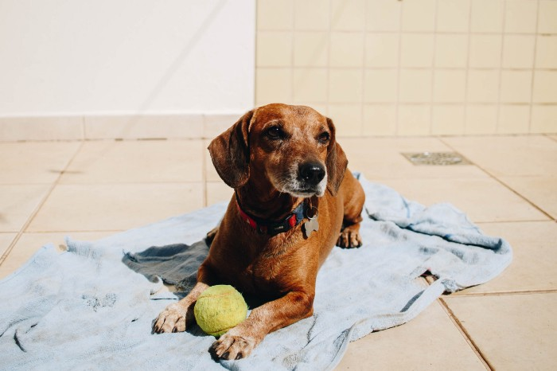
Intro
“A puppy on a blue towel” or “ A brown dog playing with a green ball”
Image captioning. It is the process of generating textual description from an image.
The first part is handled by CNNs and the second is handled by RNNs.

Slide 3

Related works
• This problem was well researched by Andrej Karapathy in his PhD thesis at Stanford, who is also now the Director of AI at Tesla.
• To get a better feel of this problem, I strongly recommend to use this state-of-the-art system created by Microsoft called as Caption Bot. Just go to this link and try uploading any picture you want; this system will generate a caption for it.
Motivation
Aid to the blind
Self driving cars
In web development
Automatic Captioning can help, make Google Image Search better
Image tagging for Ecommerce
CCTV Cameras

Slide 4
Course Overview
Group Collaboration:
Since CSE299
Meeting Time
Problems
Collaboration
Who did what

Slide 5
What part of the project is the most Original
Developing Deep Learning Model -> Google Colab
Dataset: Flicker8K
Check for some data quality.
Format data to make it consistent.
Reducing data & Decompose data.
Train With Progressive Loading (NEW)
Generate New Captions
Evaluate Model
Future Plan
Bangla Image Captioning
We are working on our own Dataset
Dataset: Dhaka2k21 (2k Images)
Preparing Photo Data
Preparing Text Data

Slide 6
Design Approach
Models: RNN + CNN
How to combine image and and sentence?
RNN + CNN:
Encoder-decoder model
Multimodal layer
x
i
Embedding Vector
Output
Input
CNN
RNN
<sos>
x̅
x̅
2
3
R
R
<eos>
x̅
x̅
1
2

Slide 7
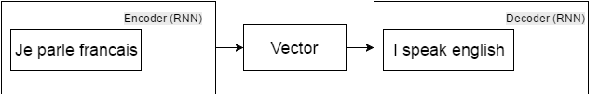
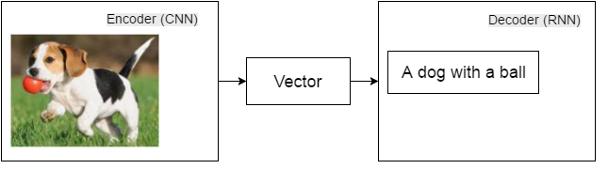
Encoder-decoder model: machine translation
Encoder-decoder model: image caption

Slide 8
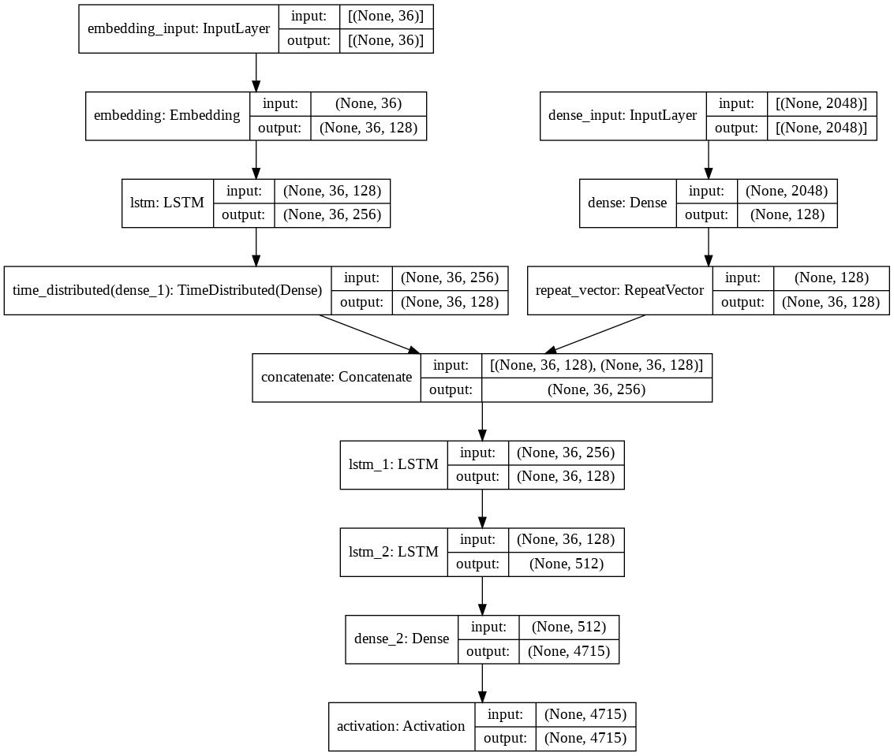
EncoderCNN
Extract feature vector from input image
Based on pretrained ResNet50
Only require very small modifies
DecoderRNN
LSTM: Long Short Term Memory networks
Multiple Copies of the same network
Contained three gates to control the cell state
Capable of learning long-term dependencies.

Slide 9






Tools
Dense
Flatten
Convolution2D
Dropout
LSTM
TimeDistributed
Embedding, Bidirectional
Activation
RepeatVector
Concatenate
pretrained Convolutional neural network - ResNet50

Slide 10
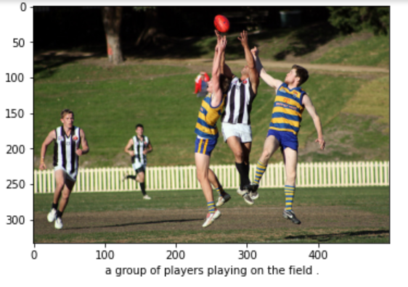
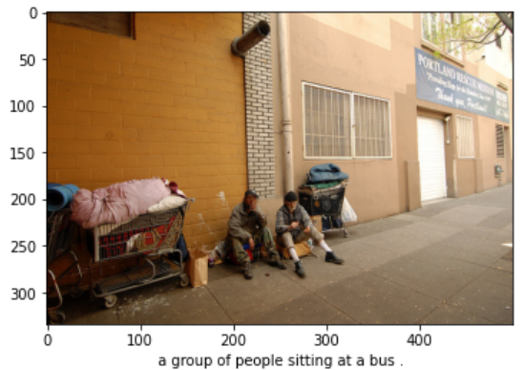
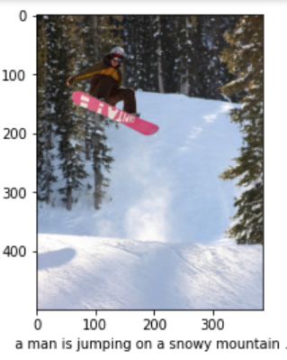
Results Analysis
Accurecy ->
We have seen that we can describe the above images in several ways. So, how do we evaluate our model? For a sequence to sequence problems, like summarization, language translations, or captioning we use a Metrics called the BLEU score.
BLEU stands for Bilingual Evaluation Understudy. It is a metric for evaluating a generated sentence to a reference sentence. The perfect match is 1.0 and a perfect mismatch is 0.0.

